Slide 1

CompSci 471
Artificial Intelligence
hidden state
Lesson 23: Hidden Markov Models
X₀
X₁
X₂
X₃
Predict → Observe → Update → Repeat
E₀
E₁
E₂
E₃
noisy observations
An HMM tracks belief about a hidden state using transitions and noisy evidence.
Fall 2026
CS 471 | L23: Hidden Markov Models
Notes:
Opening (about 1 minute). Emphasize continuity: L22 already taught the state-transition part. Today we make the state hidden and add noisy observations. Do not introduce the forward-algorithm equation yet.

Slide 2
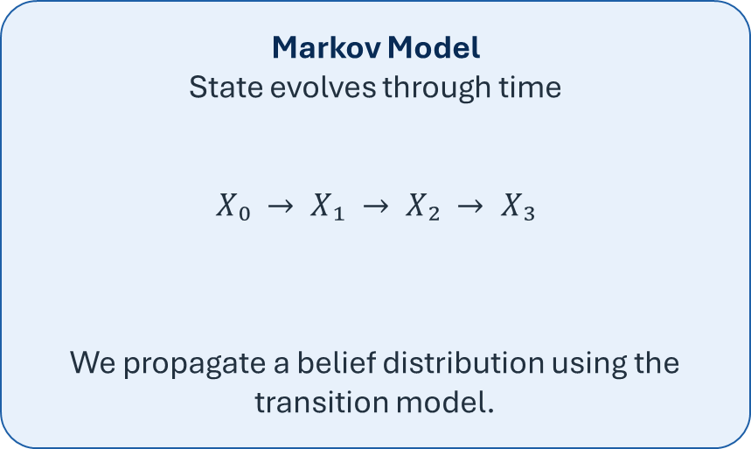
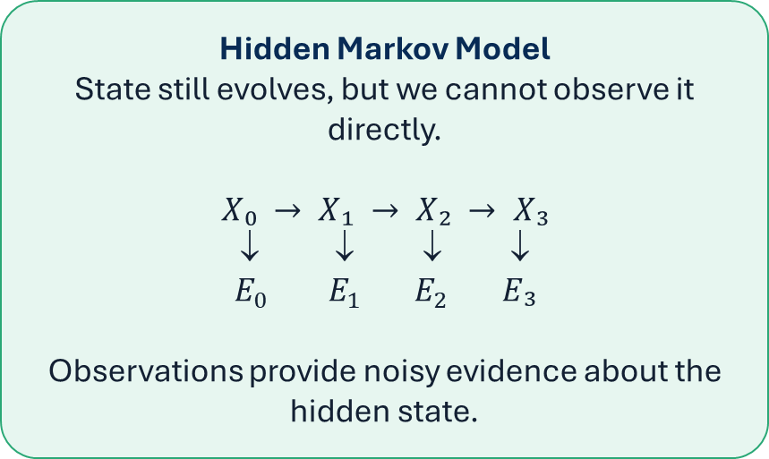
The addition of an observation model
L23 adds one new ingredient to the temporal model from L22.
Markov Model
State evolves through time
$$X₀ → X₁ → X₂ → X₃$$
We propagate a belief distribution using the transition model.
Hidden Markov Model
State still evolves, but we cannot observe it directly.
$$X₀ → X₁ → X₂ → X₃$$
↓ ↓ ↓ ↓
$$E_{0} E_{1} E_{2} E₃$$
Observations provide noisy evidence about the hidden state.
The transition model stays. L23 adds an observation model.
CS 471 | L23: Hidden Markov Models
Notes:
Ask: “What changed?” Desired answer: the true state is no longer directly observed, and we now receive evidence variables. Keep this to about 90 seconds.

Slide 3
Today’s mission
Update your belief of hidden state variables from observations.
1
Distinguish hidden state variables from observable evidence variables in an HMM.
2
Interpret the initial, transition, and observation models that define an HMM.
3
Perform a one-step Predict → Observe → Normalize belief update.
4
Interpret how sequential observations change belief about hidden states over time.
Performance target: update a hidden-state belief from a transition and a noisy sensor reading.
CS 471 | L23: Hidden Markov Models
Notes:
Preview the scope. Viterbi and particle filtering will be mentioned later only as conceptual extensions. The assessed skill is a small filtering update and interpretation.

Slide 4
L22 + L19 = Hidden Markov Models
Two familiar ideas combine into one repeated inference cycle.
L22
L19
L23
Markov prediction
Current belief
→ transition model
→ predicted belief
Bayes update
Prior
× likelihood
→ normalize
→ posterior
HMM filtering
Predict
→ observe
→ update
→ repeat
+
=
Today is not a new probability universe—we are combining two operations you already know.
CS 471 | L23: Hidden Markov Models
Notes:
Use this as the lesson organizer. Students should recognize both halves. Say “If prediction and Bayes each made sense separately, the HMM update is just their composition.”

Slide 5
Two kinds of variables
An HMM separates what is true from what we can observe.
Hidden state Xₜ
Observation / evidence Eₜ
The condition we care about but cannot directly see.
Examples:
• actual system health
• actual robot location
• actual compromise state
A measurable signal whose probability depends on the hidden state.
Examples:
• warning light
• range-sensor reading
• IDS alert
Evidence is information about the hidden state—it is not the hidden state itself.
CS 471 | L23: Hidden Markov Models
Notes:
This distinction is crucial. Ask for one student example of a hidden quantity and a noisy observation of it. Reinforce that an alert is not identical to a fault.

Slide 6


Persistent example: system health
We will extend the same Healthy/Degraded model from L22.
Hidden state
$$Xₜ ∈ \{ \text{Healthy}, \text{Degraded} \}$$
We maintain a probability distribution over the true condition.
Xₜ
Xₜ₊₁
Observed signal
Eₜ₊₁
$$Eₜ ∈ \{ \text{Alert}, \text{Normal} \}$$
The monitor is informative, but imperfect.
The only new ingredient relative to L22 is the noisy observation.
CS 471 | L23: Hidden Markov Models
Notes:
Keep the context generic so it transfers to computing, cyber, spacecraft, and maintenance examples. Ask: “Can we know X directly?” In this lesson, no.

Slide 7
You Try: hidden or observed?
Classify each pair before we calculate anything.
Scenario
Hidden variable
Observed variable
Robot navigation
actual location
range-sensor reading
Cyber defense
actual compromise state
IDS alert
Weather
actual weather
forecast/sensor reading
Equipment
internal condition
warning signal
Ask: Why do we need a probability distribution over the hidden state?
CS 471 | L23: Hidden Markov Models
Notes:
Pause about 60–90 seconds. Answers are shown in the table. Follow-up: because observations are noisy and the state may change, we represent uncertainty rather than asserting a single state.

Slide 8
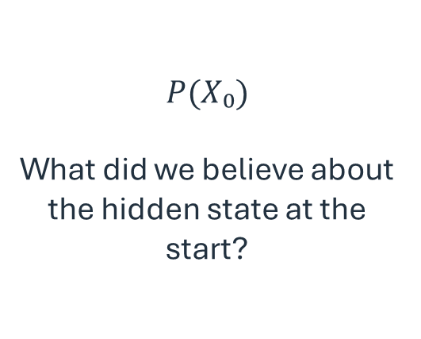
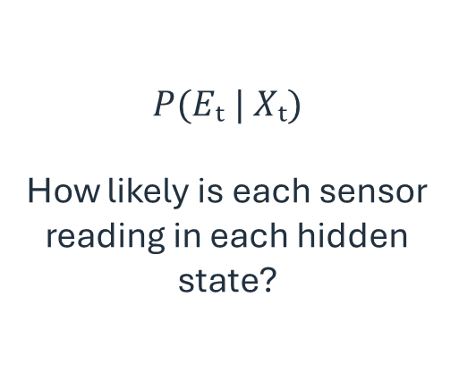
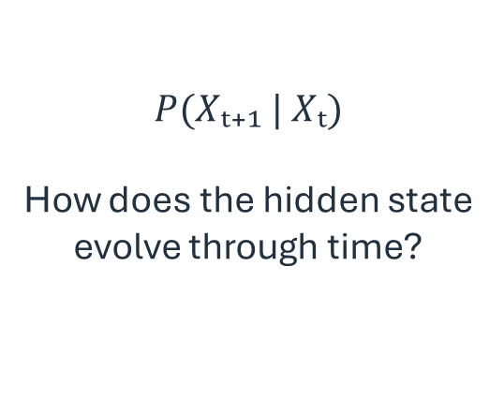
What defines an HMM?
A compact HMM needs three probability models.
1. Initial distribution
2. Transition model
3. Observation model
$$P(X₀)$$
What did we believe about the hidden state at the start?
$$P(Xₜ₊₁ | Xₜ)$$
How does the hidden state evolve through time?
$$P(Eₜ | Xₜ)$$
How likely is each sensor reading in each hidden state?
Initial belief + state dynamics + sensor behavior = the HMM.
CS 471 | L23: Hidden Markov Models
Notes:
Introduce “observation model” and optionally mention “emission model” or “sensor model” as synonyms. Do not add new math here.

Slide 9



The HMM filtering cycle
Advance one time step by predicting first, then correcting with evidence.
Current belief
PREDICT
Predicted belief
OBSERVE + UPDATE
Posterior belief
$$bₜ$$
$$b_{t+1}^{−}= bₜP$$
× likelihood
then normalize
$$bₜ₊₁$$
REPEAT
Filtering asks: “What should I believe about the hidden state now, given evidence so far?”
CS 471 | L23: Hidden Markov Models
Notes:
This is the primary algorithmic picture. Spend time here. Students should be able to narrate the cycle without equations.

Slide 10
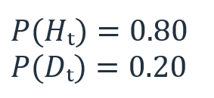

Initial belief
Belief means a probability distribution over the hidden state.
At time t
$$bₜ = [0.80, 0.20]$$
Healthy
0.8
Degraded
0.2
We do not know the state with certainty.
We maintain a belief about it.
A belief state is just a probability distribution—same idea as L18.
CS 471 | L23: Hidden Markov Models
Notes:
Keep b_t notation light. Students need the concept more than the symbol. Ask them to verify that the belief sums to 1.

Slide 11
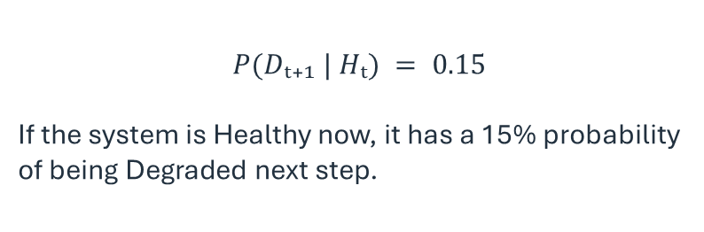
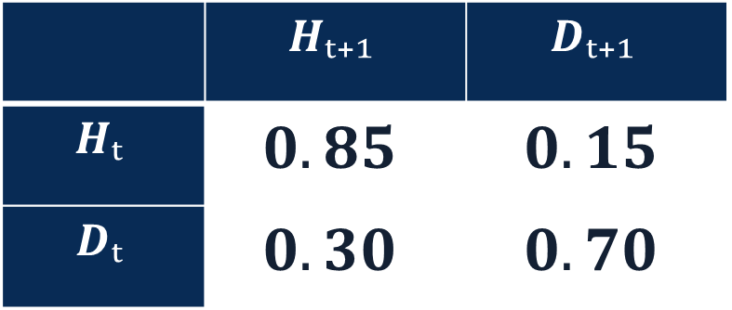
Transition model
This is exactly the model from L22.
 | $$Hₜ₊₁$$ | $$Dₜ₊₁$$
$$Hₜ$$ | $$0.85$$ | $$0.15$$
$$Dₜ$$ | $$0.30$$ | $$0.70$$
Read one entry
$$P(Dₜ₊₁ | Hₜ) = 0.15$$
If the system is Healthy now, it has a 15% probability of being Degraded next step.
Rows = current hidden state. Columns = next hidden state.
CS 471 | L23: Hidden Markov Models
Notes:
Brief retrieval from L22. Ask what 0.30 means. Answer: P(H_{t+1}|D_t)=0.30. Do not reteach matrix orientation at length.

Slide 12
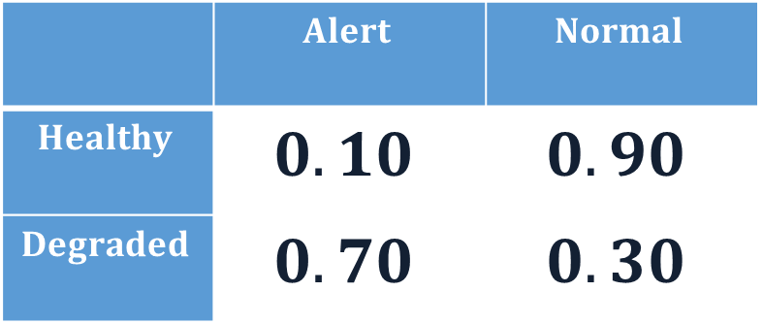
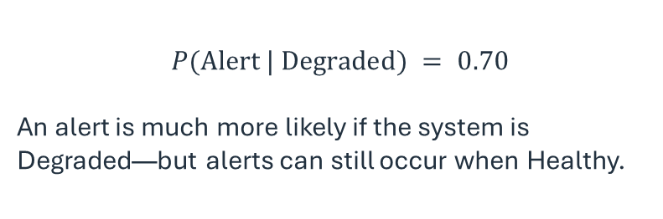
Observation model
The observation is noisy evidence about the hidden state.
 | $$Alert$$ | $$Normal$$
$$Healthy$$ | $$0.10$$ | $$0.90$$
$$Degraded$$ | $$0.70$$ | $$0.30$$
$$P(\text{Alert} | \text{Degraded}) = 0.70$$
An alert is much more likely if the system is Degraded—but alerts can still occur when Healthy.
$$P(\text{Alert} | \text{Degraded}) ≠ P(\text{Degraded} | \text{Alert})$$
L19 returns: likelihood is not the posterior.
CS 471 | L23: Hidden Markov Models
Notes:
Use this to retrieve the “reverse conditional” misconception from Bayes. The sensor model gives P(observation|state), not P(state|observation).

Slide 13
You Try: read the observation model
Interpret the sensor table before we update the belief.
 | $$Alert$$ | $$Normal$$
$$Healthy$$ | $$0.10$$ | $$0.90$$
$$Degraded$$ | $$0.70$$ | $$0.30$$
What is P(Alert | Healthy)?
What is P(Normal | Degraded)?
Which observation provides stronger evidence for Degraded?
Does an Alert guarantee that the system is Degraded?
10%
30%
Alert
No!
Focus on interpretation, not Bayes arithmetic yet.
CS 471 | L23: Hidden Markov Models
Notes:
Answers: 0.10; 0.30; Alert; No. A Healthy system can still produce an Alert with probability 0.10.

Slide 14
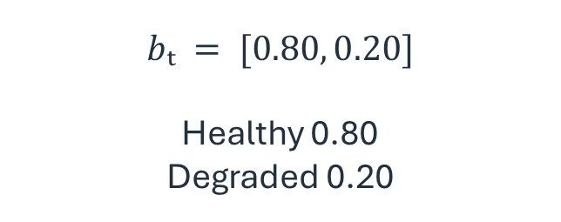
Step 1: Predict
Start from the current belief before the next sensor reading arrives.
Current belief
Question
$$bₜ = [0.80, 0.20]$$
Healthy 0.80
Degraded 0.20
What should we believe at time t+1
BEFORE seeing the next observation?
Prediction uses only the transition model.
CS 471 | L23: Hidden Markov Models
Notes:
Start updating the belief with observations. Ask students what operation to use. They should say the same propagation used in L22.

Slide 15
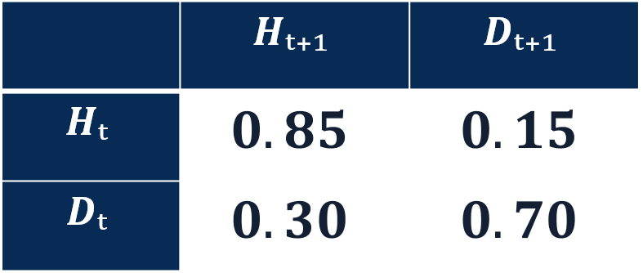
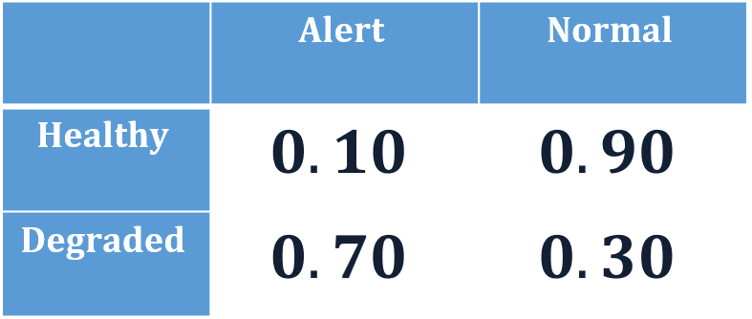
Predict the next belief
Everything on this slide is just L22.
$$bₜ = [0.80, 0.20]$$
Healthy: (0.80)(0.85) + (0.20)(0.30) = 0.74
Degraded: (0.80)(0.15) + (0.20)(0.70) = 0.26
Predicted belief
$$b_{t+1}^{−}= [0.74, 0.26]$$
Healthy
0.74
Degraded
0.26
The superscript “−” means predicted belief before the new observation.
CS 471 | L23: Hidden Markov Models
Notes:
Walk quickly through both pathway sums. Do not require the b-minus notation. It is a useful label for the intermediate distribution. Students should notice that only the transition model was used.

Slide 16
Interpret the prediction
Time changes our belief even before new evidence arrives.
Healthy at t
0.8
Healthy at t+1
0.74
Degraded at t
0.2
Degraded at t+1
0.26
Why did Degraded increase?
The transition model allows a Healthy system to degrade and a Degraded system to persist.
The predicted belief accounts for both pathways.
Prediction uses only the transition model.
CS 471 | L23: Hidden Markov Models
Notes:
Make students interpret direction before moving on to step 2. This prevents the process from becoming pure arithmetic.

Slide 17


Step 2: Observe
Now a sensor reading arrives.
Predicted belief
New evidence
Healthy 0.74
Degraded 0.26
$Eₜ₊₁ =$Alert
+
$$P(\text{Alert} | H)=0.10$$
Before calculating:
should belief in Degraded increase or decrease?
Predict the direction first. Then calculate the size of the update.
CS 471 | L23: Hidden Markov Models
Notes:
Pause for a verbal prediction: Degraded should increase because Alert is much more likely in the Degraded state.
𝑃("Alert" | 𝐻)=0.10
𝑃("Alert" | 𝐷)=0.70

Slide 18
Bayes return
Use the predicted belief as the prior for the sensor update.
L19 pattern
Posterior ∝ Likelihood × Prior
Then normalize.
HMM observation update
Updated belief ∝ Observation likelihood × Predicted belief
Then normalize.
The “prior” in this Bayes update is the belief predicted from the transition model.
CS 471 | L23: Hidden Markov Models
Notes:
This is the key conceptual bridge. Say explicitly: “We did not discard Bayes when we moved to temporal models—we use it at every time step.”

Slide 19
Reweight by the observation likelihood
How compatible is the Alert with each possible hidden state?
State
Predicted belief
P(Alert | state)
Weight
Healthy
0.74
0.10
0.074
Degraded
0.26
0.70
0.182
0.74 × 0.10 = 0.074
0.26 × 0.70 = 0.182
These are evidence-weighted values, not yet a probability distribution.
CS 471 | L23: Hidden Markov Models
Notes:
Emphasize multiply, not divide yet. Ask students if the weights sum to 1. They don’t, so the next step is normalization.

Slide 20
Normalize the weights
Turn the evidence-weighted values back into a probability distribution.
Total weight = 0.074 + 0.182 = 0.256
Healthy posterior
Degraded posterior
0.074 / 0.256 ≈ 0.289
0.182 / 0.256 ≈ 0.711
Updated belief: $bₜ₊₁ ≈ [0.289, 0.711]$
Is this a probability distribution?
CS 471 | L23: Hidden Markov Models
Notes:
This is the step that connects directly to L19/L21 normalization. Students should be able to explain why normalization is necessary.

Slide 21
What each operation is doing
Use the question behind each step to debug your reasoning.
PREDICT
OBSERVE / REWEIGHT
NORMALIZE
What might the hidden state have become?
Use the transition model.
Sum over the possible previous states.
How compatible is the new reading with each possible state?
Use the observation likelihood.
Multiply.
Turn the evidence-weighted values into a probability distribution.
Divide by the total weight.
Predict = sum pathways. Observe = multiply likelihood. Normalize = restore a distribution.
CS 471 | L23: Hidden Markov Models
Notes:
This slide explicitly prepares the later “multiply, sum, normalize” synthesis.

Slide 22
Compute → Interpret → Compare
The number matters only if we can explain what changed and why.
Predicted H
0.74
Posterior H
0.289
Predicted D
0.26
Posterior D
0.711
Compute
Interpret
Compare
P(Dₜ₊₁ | Alert) ≈ 0.711
After the alert, the system is believed to be Degraded with
about 71% probability.
Belief in Degraded rose from 0.26 to 0.711 because Alert strongly favors D.
An observation changes belief according to how diagnostic that observation is.
CS 471 | L23: Hidden Markov Models
Notes:
Ask a student for the interpretation in one sentence. Reinforce that 0.711 is a degree of belief, not a guarantee.

Slide 23
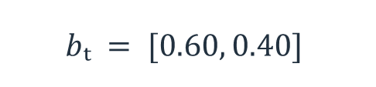
You Try: complete one filtering step
Work in pairs. Show all three stages.
Current belief
Observation model
Your tasks
$$bₜ = [0.60, 0.40]$$
P(Warning | H) = 0.20
P(Warning | D) = 0.80
Observed: Warning
1. Predict the next belief.
2. Reweight by Warning.
3. Normalize.
4. Interpret the final P(D).
H next
D next
H
0.80
0.20
D
0.25
0.75
CS 471 | L23: Hidden Markov Models
Notes:
Answer: Predict H=.60(.80)+.40(.25)=.58; D=.42. Weights: H=.58(.20)=.116; D=.42(.80)=.336; total=.452. Posterior H≈.257, D≈.743.

Slide 24
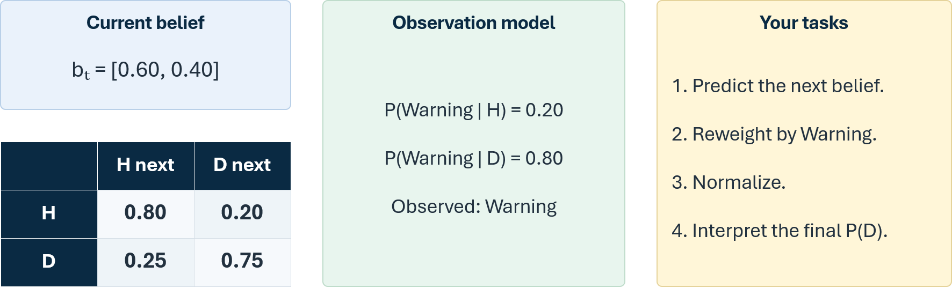
You Try: complete one filtering step (solution)
Use the same Predict → Observe → Normalize structure every time.
1. Predict
2. Reweight
3. Normalize + interpret
H: (.60)(.80)+(.40)(.25)=.58
D: (.60)(.20)+(.40)(.75)=.42
Predicted: [.58, .42]
H: (.58)(.20)=.116
D: (.42)(.80)=.336
Total = .452
H: .116/.452 ≈ .257
D: .336/.452 ≈ .743
A Warning shifts belief strongly toward Degraded.
The observation did not create the prior belief; it corrected the prediction produced by the transition model.
CS 471 | L23: Hidden Markov Models
Notes:
Answer: Predict H=.60(.80)+.40(.25)=.58; D=.42. Weights: H=.58(.20)=.116; D=.42(.80)=.336; total=.452. Posterior H≈.257, D≈.743.

Slide 25
Evidence accumulates through time
Filtering repeats as the hidden process evolves and new readings arrive.
Predict
Predict
Predict
X₀
X₁
X₂
X₃
E₀
E₁
E₂
E₃
Observe / update at each time step
What changes over time?
Passage of time can move/spread belief; observations can sharpen or redirect it.
A posterior becomes the starting belief for the next prediction.
CS 471 | L23: Hidden Markov Models
Notes:
This is conceptual. Do not compute a multi-step sequence here. Emphasize recursion: posterior at one step becomes prior belief for the next transition.

Slide 26
Sequence matters
Different evidence histories can produce different current beliefs.
Sequence A
Sequence B
Alert → Alert → Normal
Normal → Normal → Alert
Which sequence should generally leave greater belief in Degraded?
Do not calculate. Predict and justify using recency + accumulated evidence.
Evidence is interpreted in the context of the transition dynamics and all prior evidence.
CS 471 | L23: Hidden Markov Models
Notes:
Open discussion. With these likelihoods, two earlier Alerts push toward D, but a final Normal pulls back. Sequence B has a final Alert after two Normals. Exact ordering effects depend on model parameters; the key learning goal is that order can matter because prediction occurs between observations. Avoid claiming one is universally larger without calculating under a specified model.

Slide 27
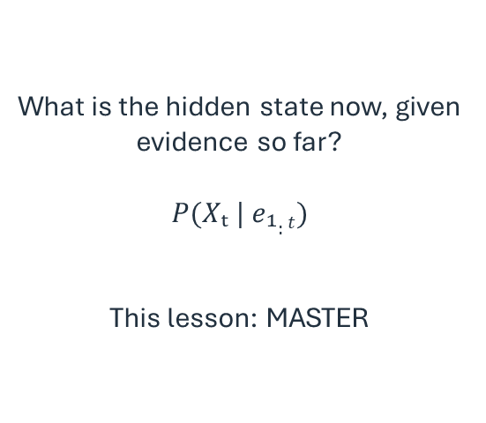
Three different HMM questions
Same model, different inference goals.
FILTERING
PREDICTION
MOST-LIKELY SEQUENCE
What is the hidden state now, given evidence so far?
$$P(Xₜ | e₁:t)$$
This lesson: MASTER
Given current evidence, what might the hidden state be later?
Propagate the current posterior without a new observation.
MASTER conceptually
What hidden-state path most likely explains the observations?
Different problem from filtering.
Conceptual exposure only
Be precise about the question before choosing an inference method.
CS 471 | L23: Hidden Markov Models

Slide 28
Advanced HMM methods (conceptual only)
Know what problem each method addresses; execution is not required.
Viterbi algorithm
Particle filtering
Goal: most likely hidden-state sequence.
Instead of summing over previous states, Viterbi keeps the best predecessor for each state and later reconstructs the best path.
You do not need to execute it in this course.
Goal: approximate belief when the state space is too large for exact inference.
Represent the belief with many samples (“particles”), move them through the transition model, then reweight/resample using observations.
Conceptual exposure only.
Filtering is exact for our small classroom HMMs; advanced methods become useful as models grow.
CS 471 | L23: Hidden Markov Models
Notes:
Keep this to 2–3 minutes maximum. (This preserves other undergraduate-level literacy without making these techniques execution requirements.)

Slide 29
Transfer: robot localization
The same HMM structure appears in many AI systems.
Hidden state
Transition model
Observation model
Robot location
Which cell / room / position is the robot actually in?
Motion uncertainty
Where might the robot move next, given its current location?
Noisy range / doorway sensor
How likely is the reading from each possible location?
Quick check: during PREDICT, which model is used? During OBSERVE, which model is used?
HMMs are a natural fit when the world changes and sensors are imperfect.
CS 471 | L23: Hidden Markov Models
Notes:
Answers: Predict uses transition; Observe uses observation/sensor model. Mention this is why robot localization is a classic HMM application.

Slide 30



Recap: the HMM filtering cycle
Advance one time step by predicting first, then correcting with evidence.
Current belief
PREDICT
Predicted belief
OBSERVE + UPDATE
Posterior belief
$$bₜ$$
$$b_{t+1}^{−}= bₜP$$
× likelihood
then normalize
$$bₜ₊₁$$
REPEAT
CS 471 | L23: Hidden Markov Models

Slide 31
Markov model vs. Hidden Markov model
L23 adds evidence correction to L22 state propagation.
Feature
Markov model
Hidden Markov model
State evolves
Yes
Yes
Transition model
Yes
Yes
True state directly available
Assumed / represented directly
No — hidden
Observation model
No
Yes
Core operation
Predict
Predict + correct
An HMM is a Markov model plus noisy observations.
CS 471 | L23: Hidden Markov Models
Notes:
Use this as a retrieval checkpoint before the culminating problem.

Slide 32
Culminating problem — predict, then update
Use the same diagram and probability tables to calculate two different values.
Sₜ₊₁
Fₜ₊₁
Warning
Normal
Xₜ
Xₜ₊₁
Sₜ
0.90
0.10
Stable
0.20
0.80
Fₜ
0.25
0.75
Faulty
0.80
0.20
Eₜ₊₁
Current belief
(a) Prediction
(b) Filtering update
P(Sₜ)=0.70
P(Fₜ)=0.30
Before the next sensor reading, calculate
P(Fₜ₊₁).
Then the sensor reports Warning. Calculate
P(Fₜ₊₁ | Warning).
For each part, show the probability pathways you use.
CS 471 | L23: Hidden Markov Models
Notes:
Give about 4–5 minutes. Part (a) requires transition prediction. Part (b) reuses that predicted distribution, applies Warning likelihoods, and normalizes. Do not reveal the answers until the next slides.

Slide 33
Culminating problem — (a) solution
First predict the Faulty probability before any new observation.
$$P(Fₜ₊₁) = P(Sₜ)P(Fₜ₊₁|Sₜ) + P(Fₜ)P(Fₜ₊₁|Fₜ)$$
= (0.70)(0.10) + (0.30)(0.75)
= 0.07 + 0.225 = 0.295
Predicted distribution
Stable = 0.705 Faulty = 0.295
Part (a) is a Markov prediction: transition model only.
CS 471 | L23: Hidden Markov Models
Notes:
Answer: P(F_{t+1})=.295. Also compute Stable=.705 because part (b) needs both states for normalization.

Slide 34
Culminating problem — (b) solution
Then incorporate the Warning observation.
State
Predicted belief
P(Warning | state)
Weight
Stable
0.705
0.20
0.141
Faulty
0.295
0.80
0.236
P(Fₜ₊₁ | Warning) = 0.236 / (0.141 + 0.236) ≈ 0.626
Normalize:
0.295 → Warning → 0.626
Prediction asks what the state may become; filtering asks what to believe after new evidence.
CS 471 | L23: Hidden Markov Models
Notes:
Answer: Stable weight .705(.20)=.141; Faulty weight .295(.80)=.236; total .377; posterior Faulty=.626. Use the 0.295→0.626 comparison to emphasize the difference between parts (a) and (b).

Slide 35
The probability block comes together
L23 is the culmination of the module’s reasoning tools.
L18
Represent uncertainty
L19
Update with evidence
L20
Structure related uncertainty
L21
Infer through structure
L22
Propagate uncertainty through time
L23
Infer hidden state through time
The module progresses from representing uncertainty to reasoning about hidden state through time.
CS 471 | L23: Hidden Markov Models
Notes:
Use this as a module map before the review workshop. It helps students organize the topics rather than treating them as six disconnected chapters.

Slide 36
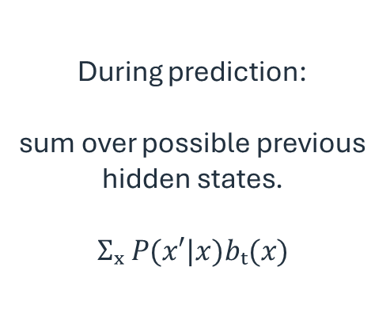
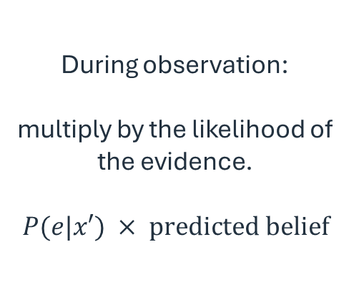
Three operations underlying everything
HMM filtering reuses the same probability moves from the entire block.
SUM
MULTIPLY
NORMALIZE
During prediction:
sum over possible previous hidden states.
$$Σₓ P(x′|x)bₜ(x)$$
During observation:
multiply by the likelihood of the evidence.
$$P(e|x′) × \text{predicted belief}$$
After reweighting:
divide by the total so the posterior sums to 1.
Compact forward update (literacy, not memorization):
$$bₜ₊₁(x′) ∝ P(eₜ₊₁ | x′) Σₓ P(x′ | x)bₜ(x)$$
The equation packages the cycle you already understand—it is not the entry point.
CS 471 | L23: Hidden Markov Models
Notes:
Only now show the compact forward-update expression. Translate left-to-right: sum pathways through the transition model, multiply by observation likelihood, normalize. Do not require memorization.

Slide 37
Exit ticket
Can you narrate the HMM update without relying on memorized symbols?
X is the __________ variable.
Xₜ
Xₜ₊₁
E is the __________ variable.
Prediction uses the __________ model.
Observation update uses the __________ model.
Eₜ₊₁
After reweighting, we __________ so probabilities sum to 1.
Next: review Module 3 concepts, combining probability, Bayes, Bayes nets, Markov models, and HMMs.
CS 471 | L23: Hidden Markov Models
Notes:
Answers: hidden; observed/evidence; transition; observation/sensor/emission; normalize. Collect quickly or have students answer aloud.

